Slide 1
Failures of Selection in Time
When new information (even if only a small amount) arrives in a rapid stream, spending time processing it will cause you to miss some other incoming information, resulting in what are called failures of selection in time.
These failures to attend to information in space or in time are a by-product of a system that prevents us from becoming overloaded with irrelevant information—that is, of a system of selective attention.

Slide 2
Sources of Limitation
As the term suggests, attentional blink is a short period during which incoming information is not registered, similar in effect to the physical blanking out of visual information during the blink of an eye.
Notes:
The interference, in the form of a slowing down of your actions, that arises when you try to select between two possible responses to even a sole sensory stimulus is referred to as a response bot­tleneck. The additional time needed to move through this kind of bottleneck has been measured experimentally. (p. 115)

Slide 3
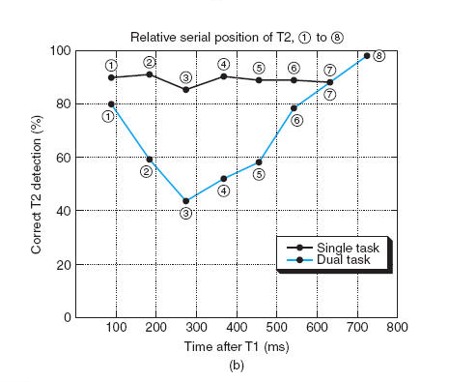
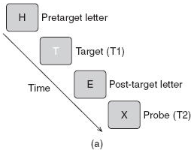
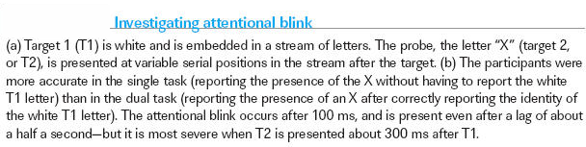
Failures of Selection in Time

Slide 4
Failures of Selection in Time
Rapid serial visual presentation (RSVP) tasks
  Watch for stimuli during a fast stream of symbols
  Report those symbols

Slide 5
$&%73*#

Slide 6
$7823%#)%

Slide 7
balloon

Slide 8
57*$36$

Slide 9
cheese

Slide 10
$30!73*#

Slide 11
$&%7482#

Slide 12
Failures of Selection in Time
Attention Blink
  People will miss words that are presented close together (Shapiro, Driver, Ward)
  About 200 to 500 ms after the first word appears

Slide 13
Failures of Selection in Time
Two Stage Model
  Chun and Potter
2 stages:
  Direction of Attention, Lexical Identification
  Consolidation to Working Memory for report.

Slide 14
Failures of Selection in Time
Interference Model
  Shapiro, Driver, Ward
  Words compete for attention

Slide 15
Failures of Selection in Time
Combination Model
  Potter
  Added a stage between lexical identification and consolidation
  Conceptual Short Term Memory (CSTM)
    Decay and Interference

Slide 16
Two stage
Interference
Combo
consolidation
CSTM
Lexical ID
balloon
balloon
balloon

Slide 17
Two stage
Interference
Combo
balloon
balloon
balloon
balloon
balloon
balloon

Slide 18
Two stage
Interference
Combo
balloon
balloon
balloon
cheese
cheese
cheese

Slide 19
Two stage
Interference
Combo
balloon
balloon
cheese
cheese
balloon
cheese

Slide 20
Two stage
Interference
Combo
balloon
cheese
balloon
balloon
Fight!
cheese
balloon
cheese
Wait!
Fight!

Slide 21
Sources of Limitation
Some models propose the notion of a bottleneck, a restriction on the amount of information that can be processed at once; because of the bottleneck, certain critical mental operations have to be carried out sequentially.
Divided-attention studies demonstrate that performance is hampered when you have to attend to two separate sources of visual information or two separate visual events. In all these cases, the decrement in performance is referred to as dual-task interference.
Notes:
The interference, in the form of a slowing down of your actions, that arises when you try to select between two possible responses to even a sole sensory stimulus is referred to as a response bot­tleneck. The additional time needed to move through this kind of bottleneck has been measured experimentally. (p. 115)

Slide 22
Problems in Interpretation
Although cognitive psychologists have spent a great deal of time and effort examining divided attention and the costs associated with dual tasks, many questions remain.
A second problem that has muddied the dual-task waters is that it is not possible to guarantee that when you do two things at the same time, you’re doing them in exactly the same way as you would if you were performing each task singly.
In the late 1970s Shiffrin & Schneider (1977) used just this terminology and described processing as being either automatic or controlled Just as our example of driving experience suggests, they found that people use automatic processing on easy or very familiar tasks but are forced to use controlled processing for difficult or new tasks.

